Slide 1
Point of Dispensing and Counselling Intervention Enhanced Service: Community Pharmacy
(PODIS)

Slide 2
LPC priorities 17/18
Quality Points
Long Term conditions
Waste
Prevention and Healthy Lifestyles.

Slide 3
Background
National Audit Office stated in 2007 that NHS England could save more then £300m annually by more efficient prescribing
Estimated £100m of drugs returned unused
National audit 2013/14 revealed that 5/200 items were prescribed but not needed by patients

Slide 4
Information
NEL CCG CoM have agreed to commission a “Point of Dispensing Counselling and Interventions Service” within Community Pharmacies across North East Lincolnshire from 1st December 2017 until 31st March 2019.
Interim solution - long term plan for embedding of electronic repeat dispensing to reduce medicines waste

Slide 5
Key aims of scheme
Proposed service will support adherence to repeat medication through an intervention by the pharmacist
Reduce unwanted medicines dispensed
Notify prescriber items not dispensed
Promote and support good prescribing practices
Reduce unnecessary prescribing costs
Highlight over or under usage of medicines to the prescriber

Slide 6
Local Context
“Pharmacy can be seen as a cost”
“Managed repeats cause waste”
LPC responded with “Not dispensed audit” in
2012 and 2016
Clearly showed pharmacy not the main cause
of “waste”

Slide 7
Local audit information
June 2016 Community Pharmacy Humber/NHS England audit across Humber pharmacies
% Figures shown are for
NE Lincs CCG

Slide 8
Financial information
Potential savings to NEL CCG £207,000 to £247,000 annually(if all pharmacies sign up)
Invest to save scheme – savings realised through CCG prescribing budget
Fees to be paid
£4 per intervention
10% of Net Ingredient cost (price as per drug tariff or DM+D) for the non-dispensed item

Slide 9
Service Overview
Mirrors the requirements of the Repeat Dispensing Service to ask:
“Are there any items on your repeat prescription that you don’t need this month? “
The pharmacy will share with the CCG the cost saving of items that are not supplied
Clinically significant interventions will be flagged to the prescriber
The initiator of the unwanted item will be given appropriate feedback

Slide 10
Flow Chart – 1st Part normal dispensing process

Slide 11
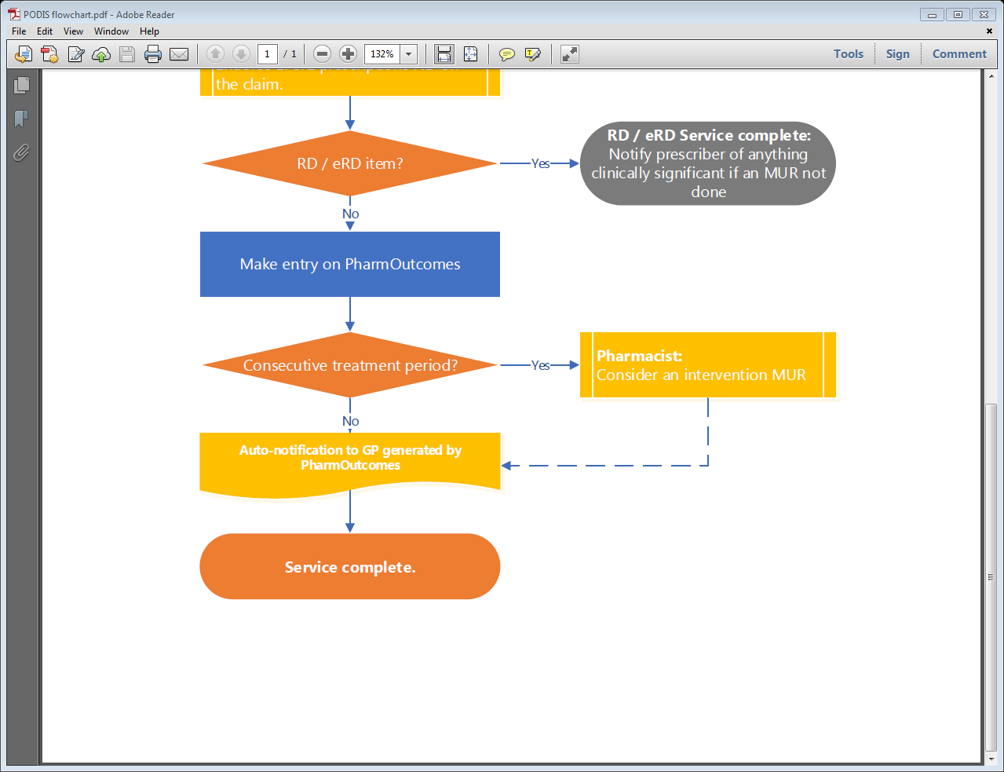
Flow Chart – 2nd Part continue to PODIS

Slide 12
Watch the webinars at:
http://communitypharmacyhumber.org/services-by-area/north-east-lincolnshire/point-of-dispensing-intervention-service-podis-nel/

Slide 13
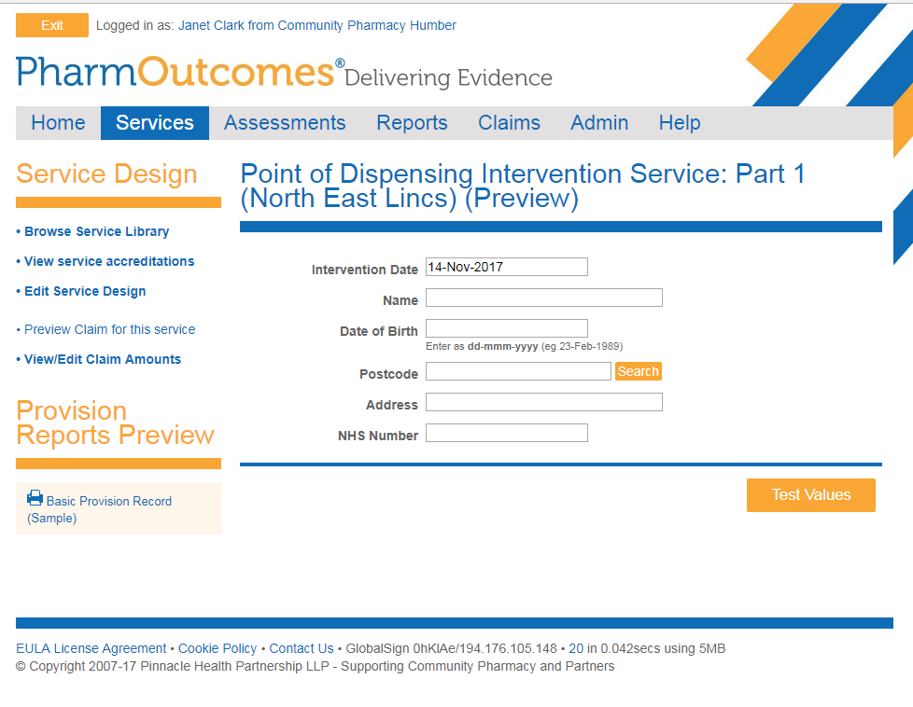
PharmOutcomes – Part 1

Slide 14
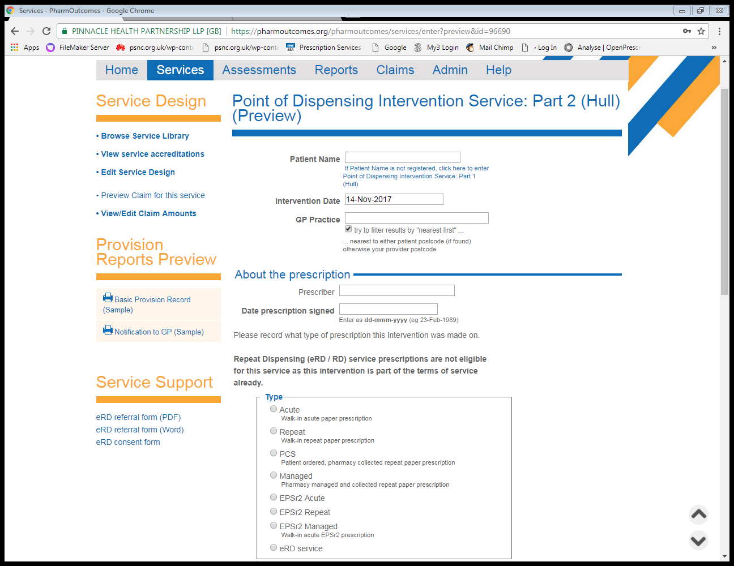
PharmOutcomes – Part 2

Slide 15
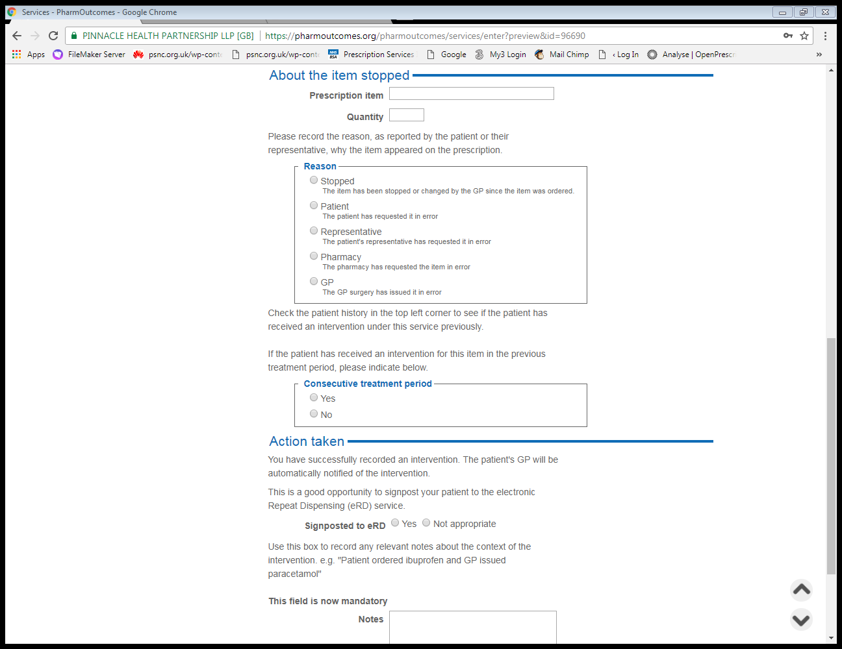
PharmOutcomes – Part 2

Slide 16
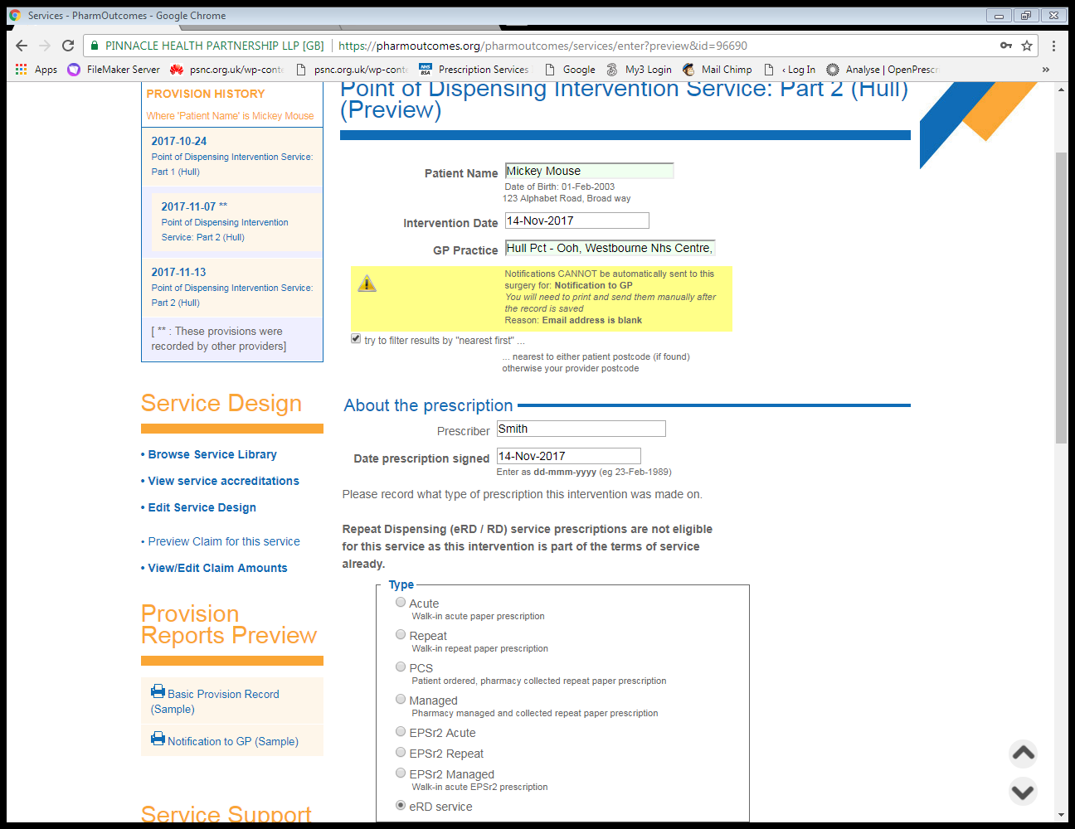
PharmOutcomes – Example eRD
If PharmOutcomes unable to send notification by email – see warning box
eRD prescriptions will not let you proceed to record an intervention

Slide 17
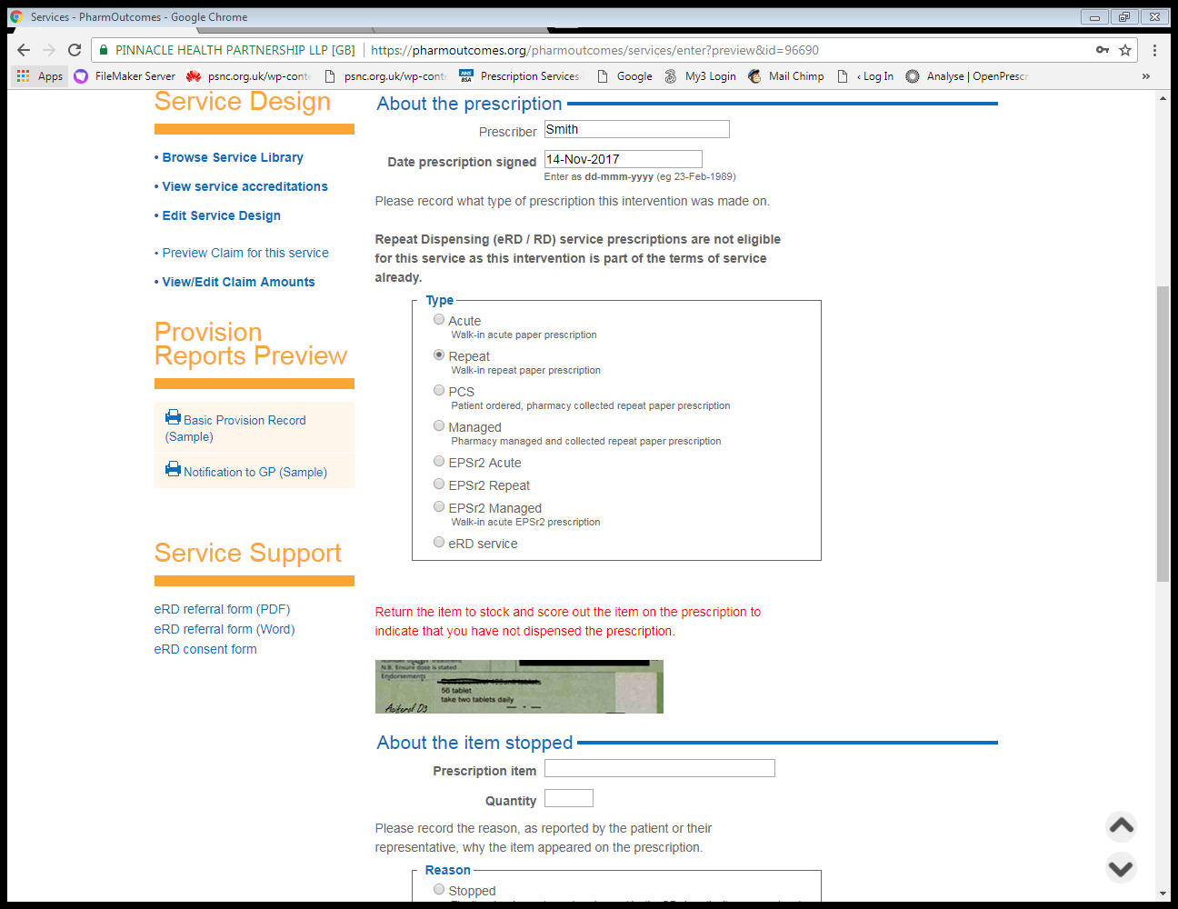
PharmOutcomes – Repeat / Endorsing
Choose type of prescription
Endorsing the prescription
Cross through item to score out and endorse not dispensed or ND
Electronic Rx follow system supplier process for not dispensed claims

Slide 18
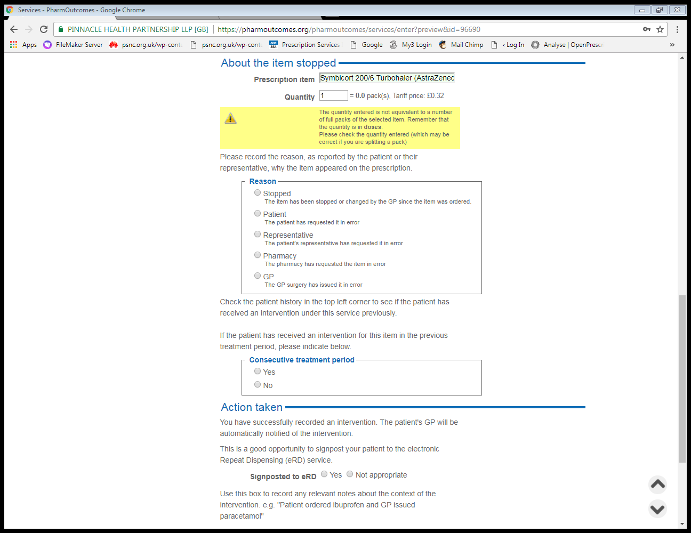
PharmOutcomes – Quantity in unit doses
Quantity should be in unit doses – see warning box

Slide 19
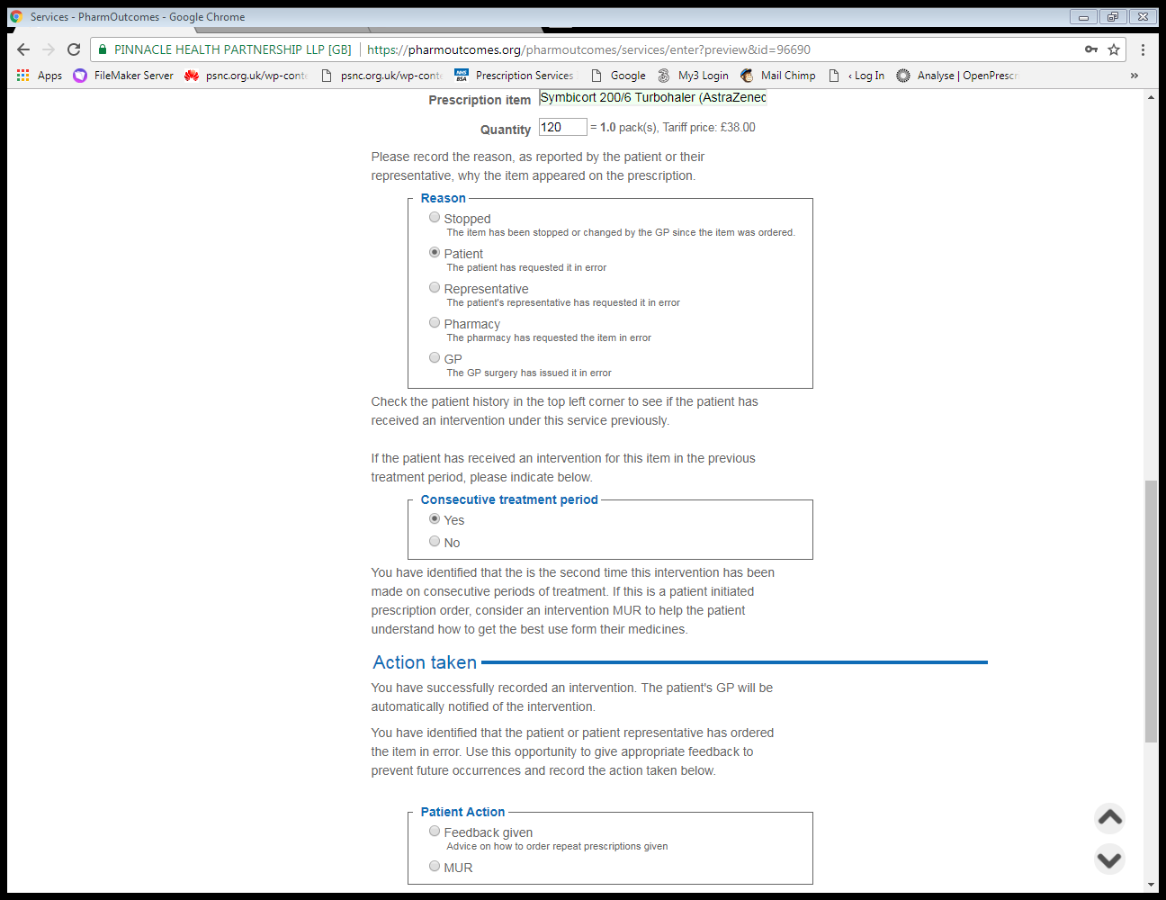
PharmOutcomes – Consecutive period of Treatment
Choose reason as reported by patient or representative
If patient has received a previous intervention under the service

Slide 20
Patient History is in the top right hand corner
If patient has previous intervention

Slide 21
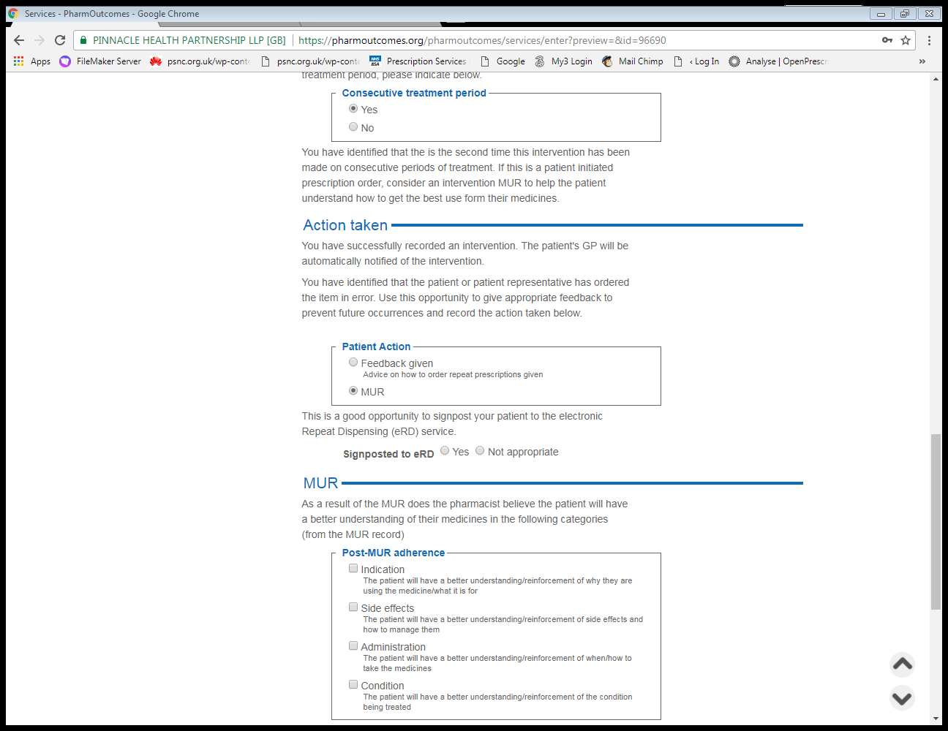
PharmOutcomes – Intervention MUR
Intervention MUR – record post-MUR adherence from MUR record

Slide 22
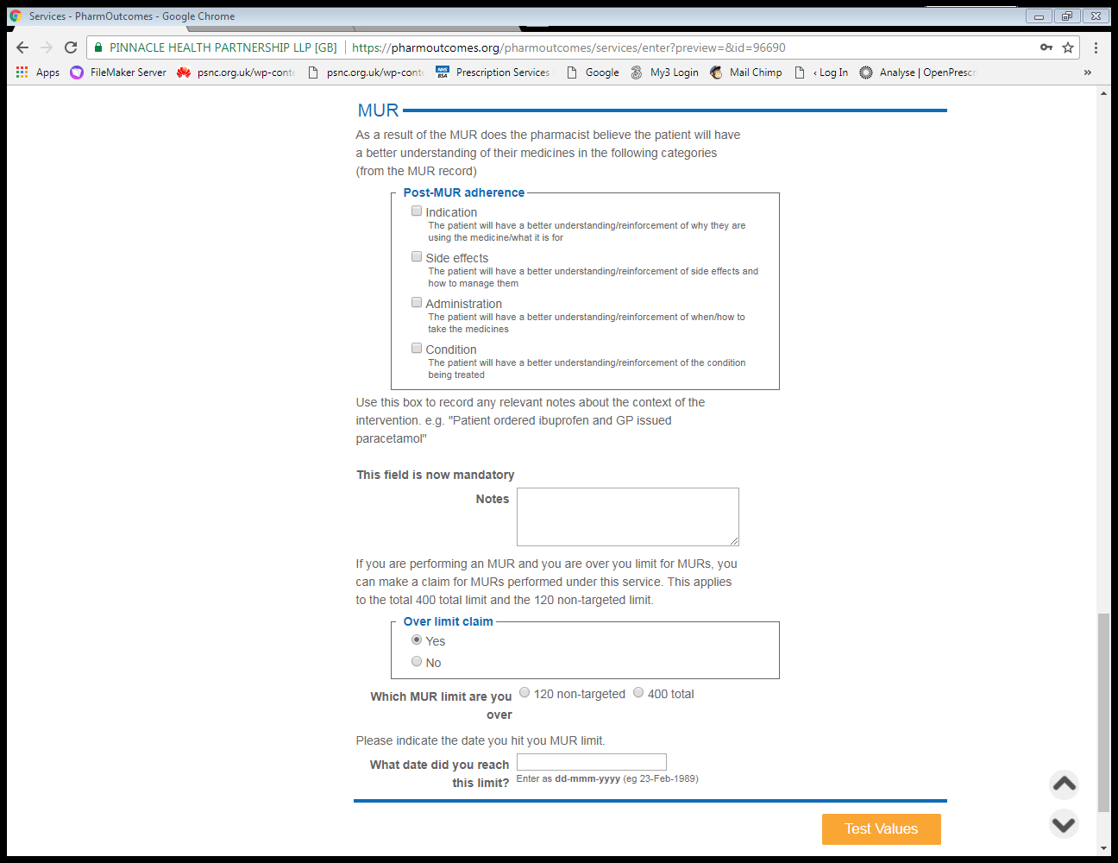
PharmOutcomes – Intervention MUR
400 MUR limit or 120 non-targeted
Record the date target reached

Slide 23
PharmOutcomes – Sign post eRD / Mandatory field
Signpost to eRD
eRD referral form
Consent form
both PO to download
Mandatory field

Slide 24
Claiming and Payments
Recorded on PharmOutcomes
Prompt to do intervention MUR
Prompt to signpost to eRD
Notification to GP
£4 + 10% of the ingredient costs saved.
Not Global Sum – additional monies!
Monthly reporting to CCG

Slide 25
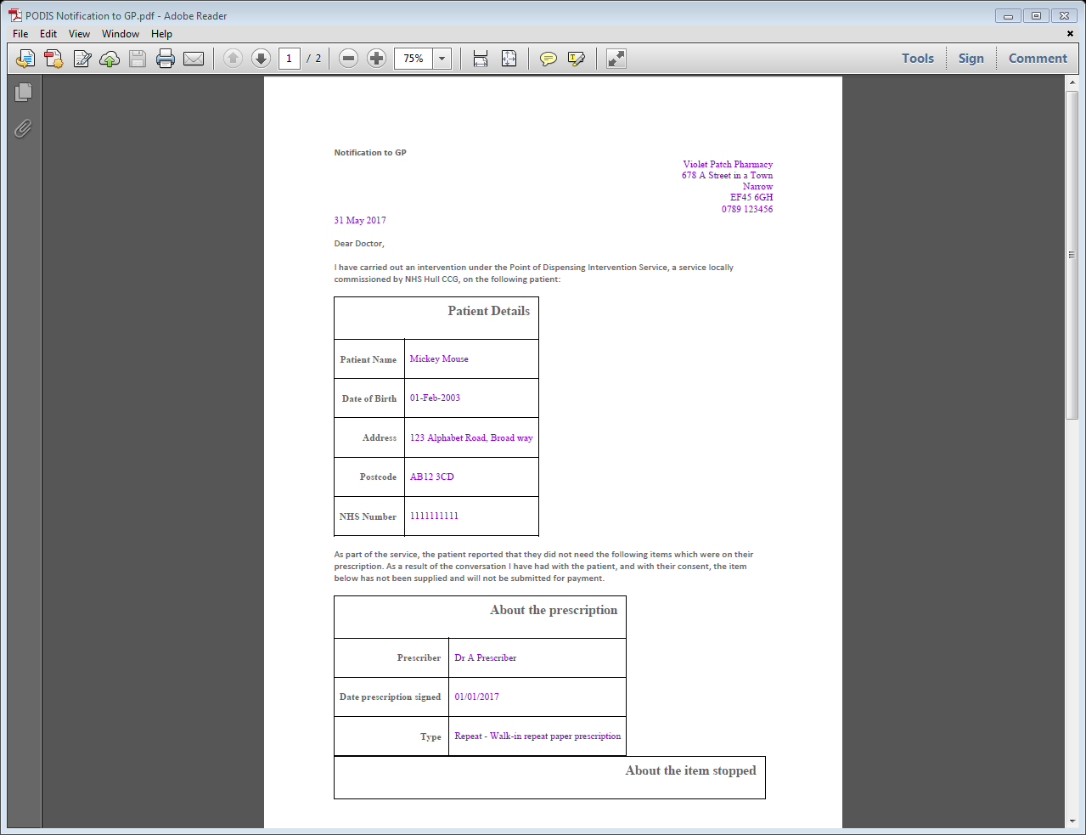
GP Notification

Slide 26
Before you start
Agree and sign SLA with NHS England
Check your SOPs
– Repeat dispensing service
– Intervention MUR
– Your prescription collection arrangements
Especially any managed service you may offer

Slide 27
eRD – The future!
Have you seen any health professional (GP, nurse
or hospital doctor) since your last repeat was
supplied?
Have you recently started taking any new
medicines - either on prescription or that you
have bought over the counter?
Have you been having any problems with your
medication or experiencing any side effects?
Are there any items on your repeat prescription
that you don’t need this month?

Slide 28
Summary
Remember this service is an intervention to be done in addition to your normal SOPs and professional responsibilities and at the point of handing out medication.
If you would have already queried and not dispensed an item as part of your SOPs then can’t include in PODIS.
In particular if you offer an ordering service for patients make sure you check your SOPs as managed repeat services must not create waste.

Slide 29
FAQs
Can I claim for care homes?
Can I claim for nomad patients?
Can I claim for managed repeats?
Can I claim for Repeat Dispensing?
Can I claim if a patient doesn’t collect an item?
Can I claim for an item we can’t obtain due to manufacturer cannot supply (MCS) or long term manufacturing problems?
Can I claim for an item where the pharmacist has made a clinical intervention e.g. drug interaction and received a replacement medication?

Slide 30
FAQs
See FAQs for Community Pharmacy….but basically
“No”

Slide 31
Any Questions?

